Slide 1
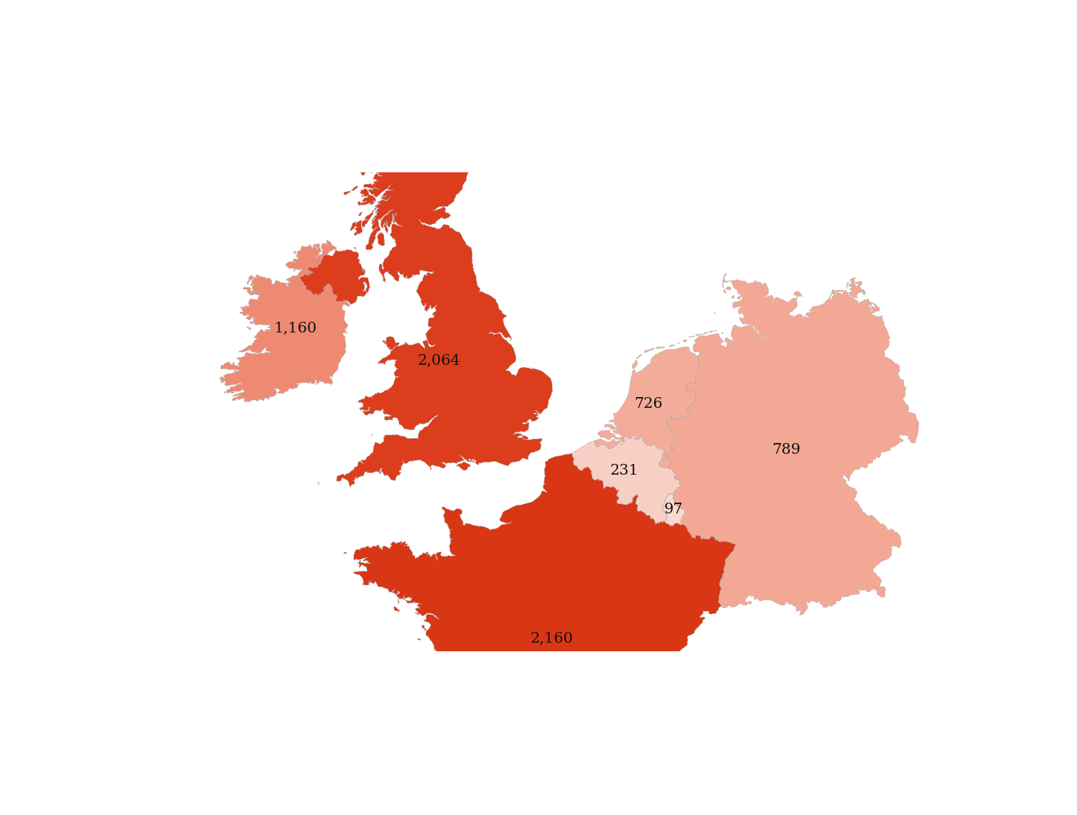
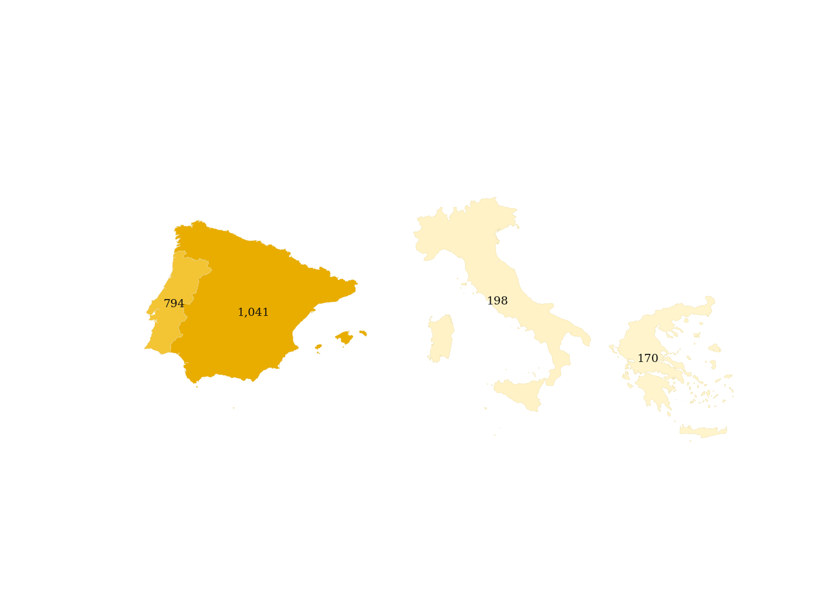
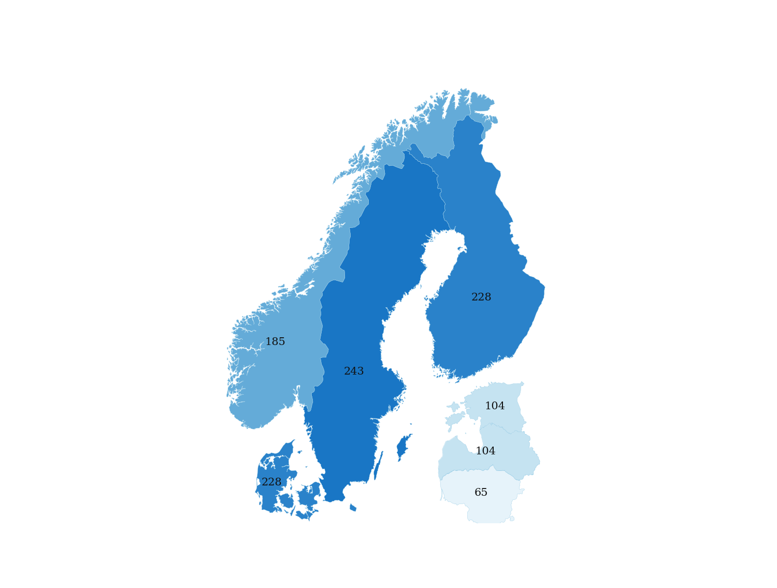
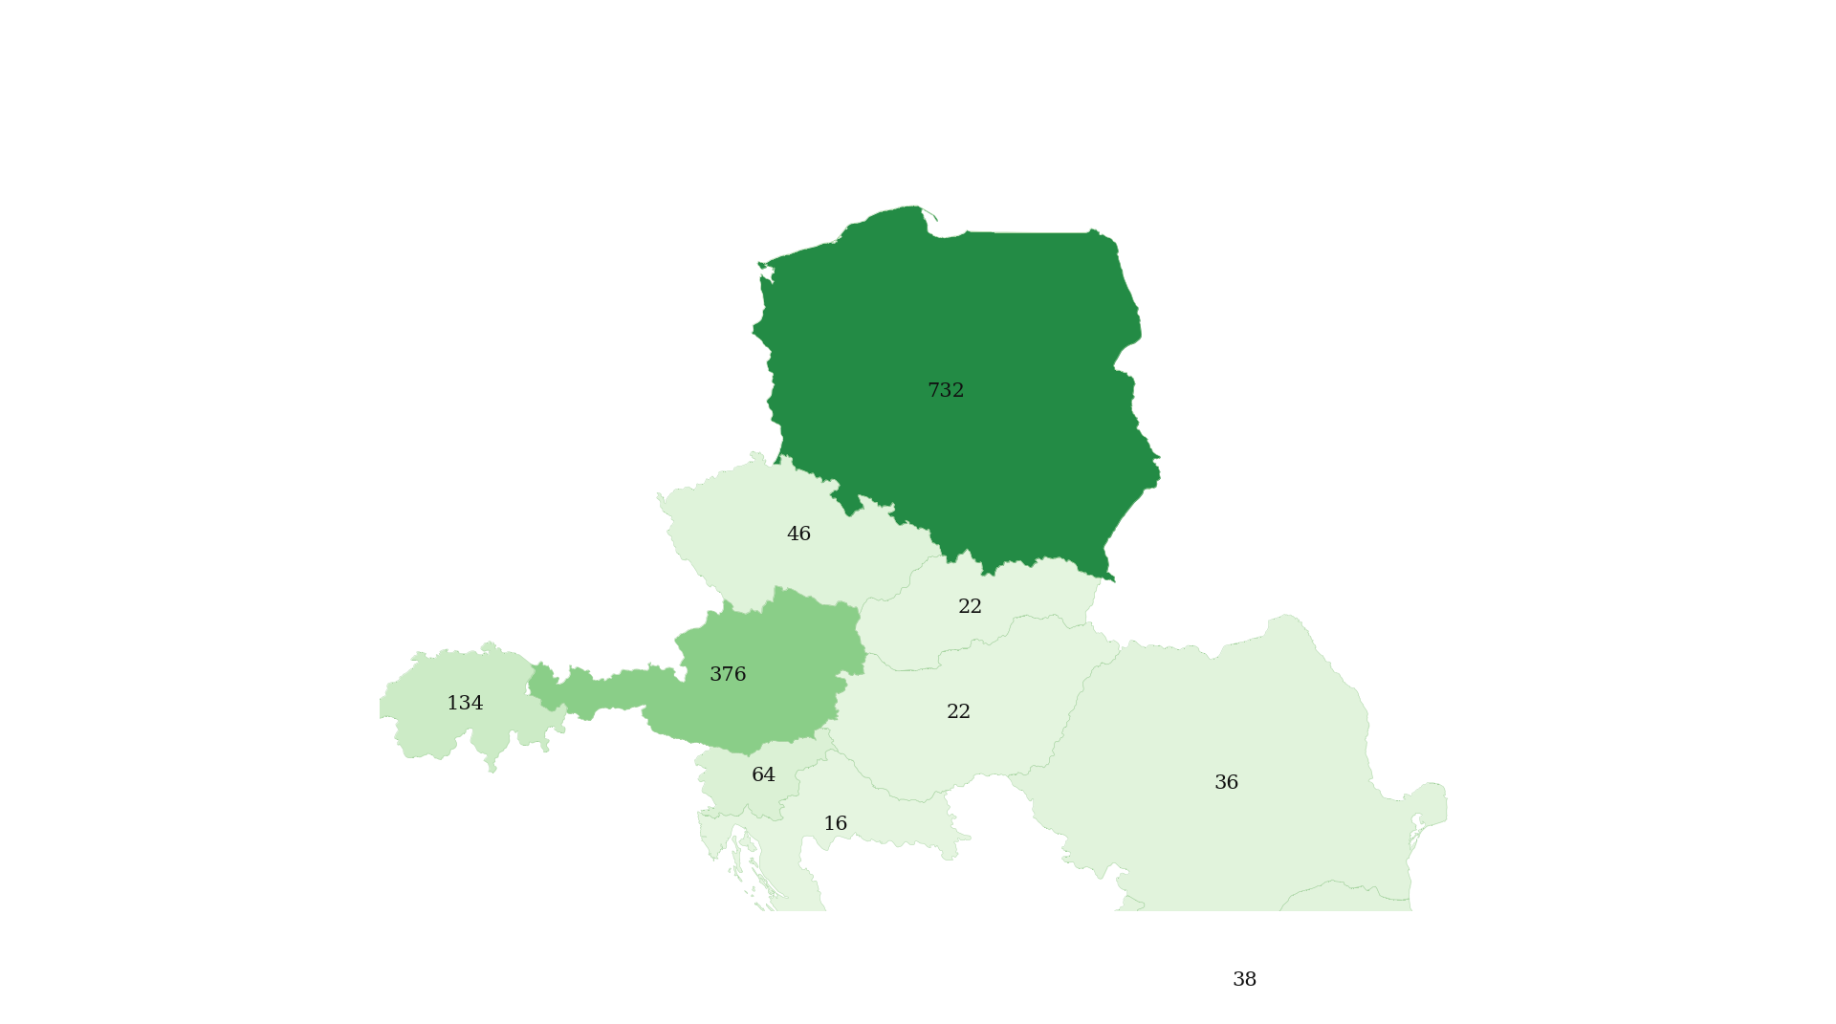
> 300 GWh/y
200-300 GWh/y
100-200 GWh/y
50-100 GWh/y
20-50 GWh/y
10-20 GWh/y
1-10 GWh/y

